Slide 1
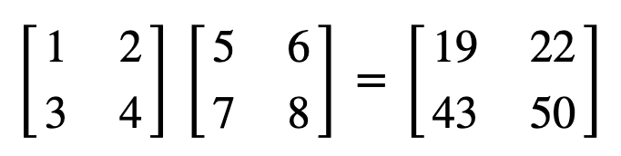
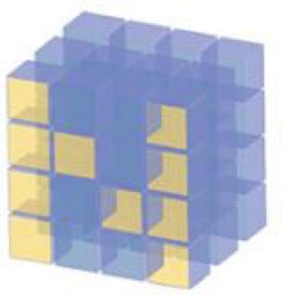
Three Different Ways of Matrix Multiplication

Slide 2
Reference
Youtube
Code

Slide 4
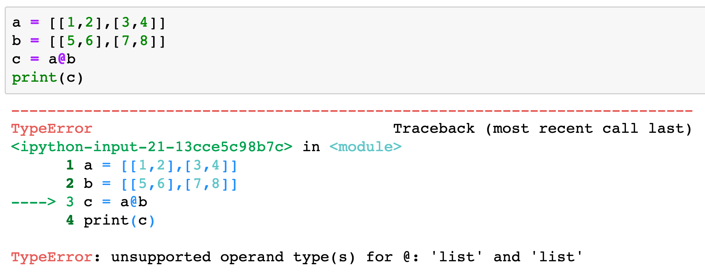

Slide 5
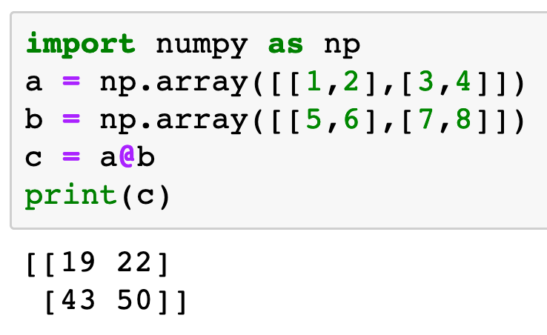

Slide 9
Three Different Ways
of Matrix Multiplication

Slide 10
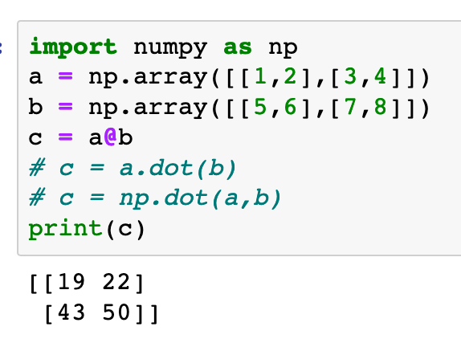
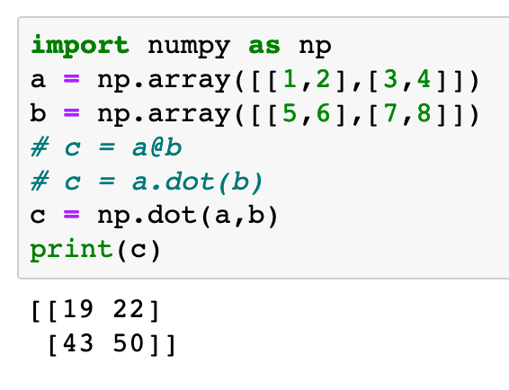
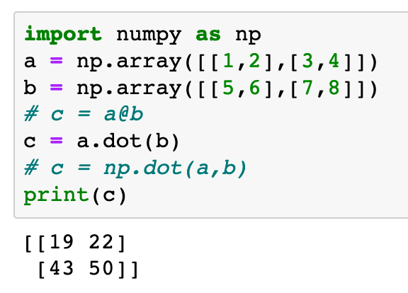

Slide 11
Python 3.5+

Slide 12
dot method
Python 3.5+

Slide 13
dot method
Python 3.5+
np.dot function

Slide 14
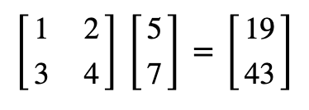
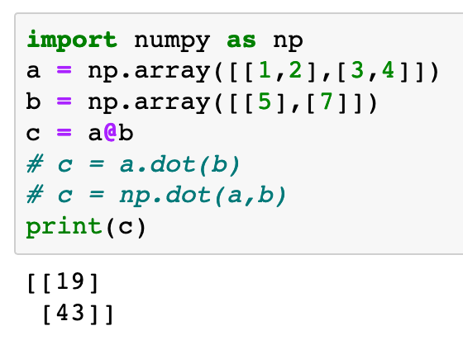
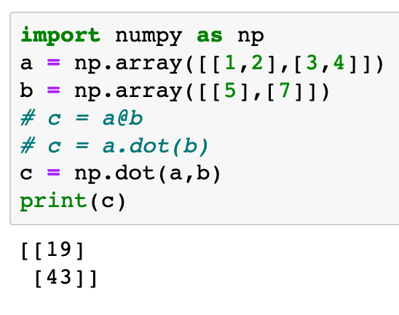
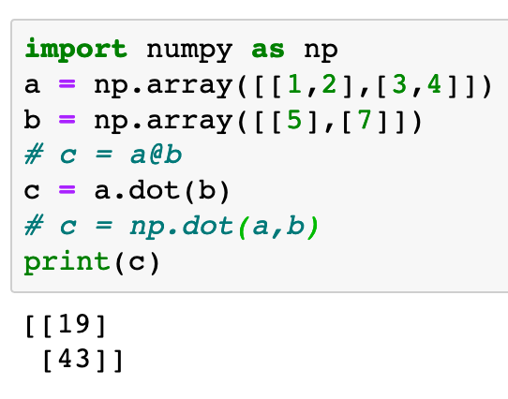
dot method
Python 3.5+
np.dot function

Slide 15
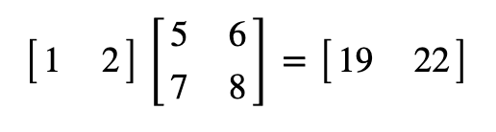
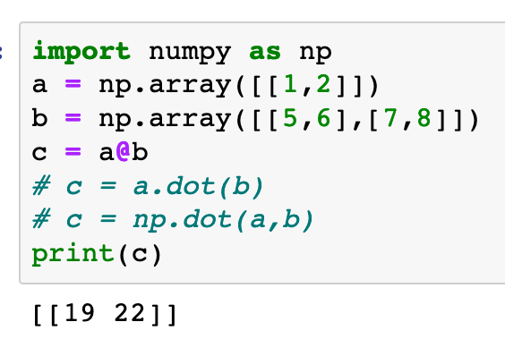
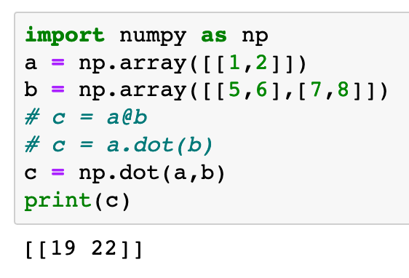
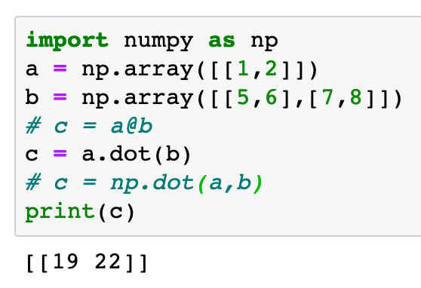
dot method
Python 3.5+
np.dot function

Slide 17
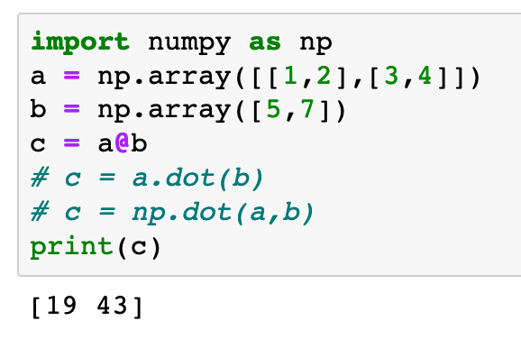

Slide 18
shape (2,1)

Slide 19
shape (2,1)
shape (2,)

Slide 20
BAD
PRACTICE
shape (2,1)
shape (2,)

Slide 21
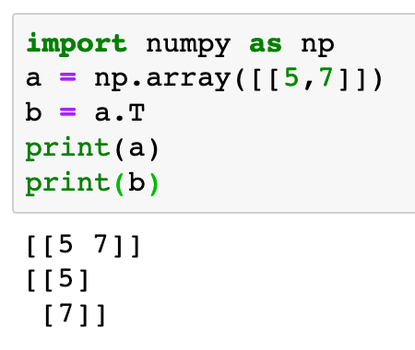
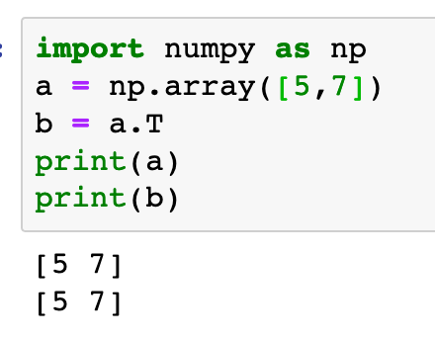

Slide 22
transpose

Slide 23
transpose
working

Slide 24
NOT
WORKING
transpose
working

Slide 26
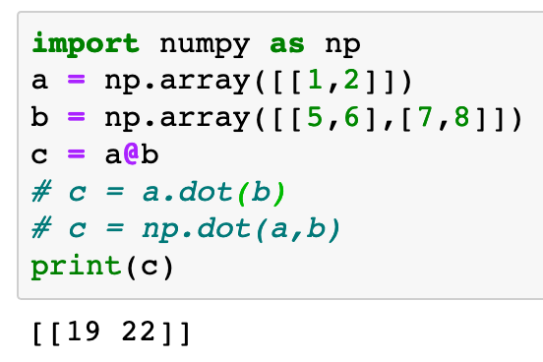
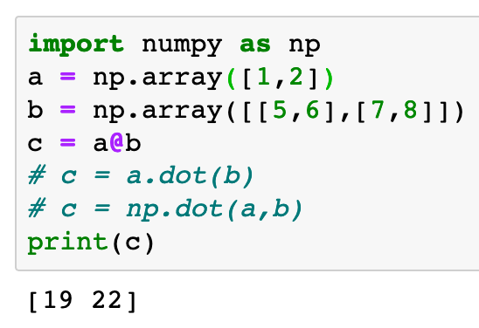

Slide 27
shape (1,2)

Slide 28
shape (1,2)
shape (2,)

Slide 29
BAD
PRACTICE
shape (1,2)
shape (2,)

Slide 30
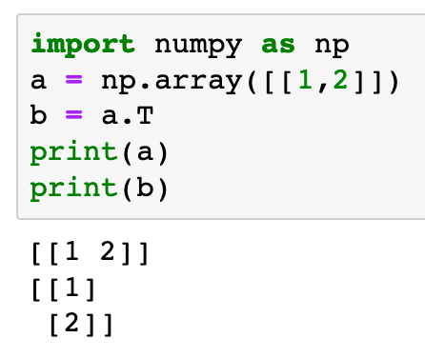
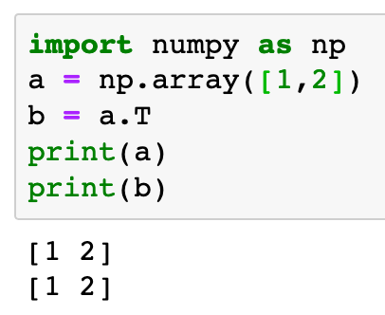

Slide 31
transpose

Slide 32
transpose
working

Slide 33
NOT
WORKING
transpose
working

Slide 34
Now
Let’s Play with Code

